Slide 1
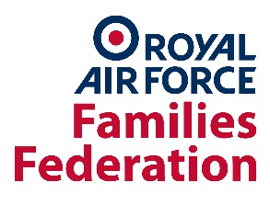
Armed Forces Family Life
Prepared by the Naval Families Federation, the Army Families Federation and the RAF Families Federation

Slide 2
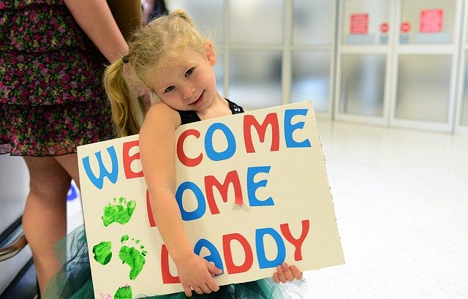
What is unique about Armed Forces family life?
The notion of 'Service First'
'Service comes first' is a principle that affects the whole family's life, not just the Service person.
Mobility
Some can move houses as much as every 18 months/2 years, some every 5 years or so, others settle in one place whilst a Serving person moves around for work
Deployment
Non-operational and operational deployments, in the UK or overseas, can vary in length and frequency. Some will be often for a few weeks/a month, others for 4-6 months every couple of years. Some may even be 9 months or longer.
Separation takes different forms. Can be from training, living apart, and/or deployment and will hence vary in length and frequency.
Image by skeeze on Pixabay

Slide 3
One example....
"I 'married in' to the Armed Forces 19 years ago......​
In that time I’ve had 2 children, 4 cats, 13 houses and 7 jobs.​
During that time I’ve had to find 4 childminders, 3 nurseries and 6 schools for the children, 13 GPs and 8 dentists (I didn’t bother for a few years)​.
I’ve given birth in 2 different hospitals​.
Had 19 hairdressers ​.
Moved house….sometimes when we wanted and to where we wanted but also at short notice, completely the wrong time and a location that would have been the last place in the world we would have chosen.​
Moved overseas and moved back again.​
Lived together. Lived apart.​
Kissed him goodbye on deployment 8 times and several months later hello​.
Made half a dozen life long friends…and myself and the children have left behind many more good ones along the way."​
Notes:
This is just one example from one family from one of the 3 services.
There are hundreds, if not thousands of others, all of varying experiences but there are very, very few families who will not have been disrupted, disjointed, upheaved and impacted by operational deployments and assignments

Slide 4
What are the positives of service family life?
Quality of life: 61% of military spouses are satisfied with their quality of life being married to a member of the Armed Forces (FAMCAS 2020).
Different cultures & backgrounds: The AFF 'Listening to our service children' survey reports that families said Army life offered children the chance to make new and diverse friends from different cultures and backgrounds. It also built skills such as resilience, confidence and tolerance.
Community: for many families, this is a key benefit which is mentioned frequently in our surveys, the chances to make friends, live with other families and children going through the same experiences, especially during deployments, separation, remote living, constant moves and unknown change.
Development of skills: The NFF's report 'The Experience of Parental Absence in Royal Navy and Royal Marines Families' lists specific skills including independence, maturity, flexibility and awareness of civic duty that service children may develop due to separation.

Slide 5
How do we live? – Mobile Armed Forces families
Families in some parts of the Armed Forces can be quite mobile – moving with the Service person from as little as every 18 months to every 5 years or more.
Each move brings challenges around access to healthcare, childcare and education and changing friendships for the whole family. Each move means finding new medical practices, education settings and for many spouses and partners finding new employment too.
For some this has its advantages as it can offer opportunities to live somewhere new, be part of new communities and have the opportunity to meet a variety of people.
These challenges can be greater for Dual serving (where both partners are serving in the Forces) or single parent serving families, where the access to immediate support especially surrounding childcare is less flexible.

Slide 6
Some families do not move with their serving family member but remain in one place whilst their Service Person commutes, sometimes opting to live at his/her unit during the week (sometimes called 'weekending'). This pattern is most common for Naval families and increasingly, for RAF families (https://nff.org.uk/non-operational-separations/)
This reduces disruption for the rest of the family – especially on education, spousal employment and healthcare.
There are pros and cons to this option too – read more in the Dispersed Living Report from the RAF Families Federation (https://www.raf-ff.org.uk/wp-content/uploads/2019/02/Dispersed-Families-FOR-WEB.pdf)
If they are living dispersed, families may be more dependent on support from their school as there is no other local welfare support available.
There are a large number of dispersed families around the UK, as well as many families living near military units.
Figures from the SCiP Alliance tell us that Service children are educated in over half of state primary and secondary schools and in all but two local authorities in England. SCP-Alliance-data-Briefing.indd (scipalliance.org)
How do we live? - Dispersed family living

Slide 7
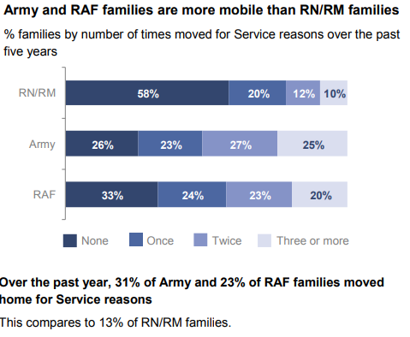
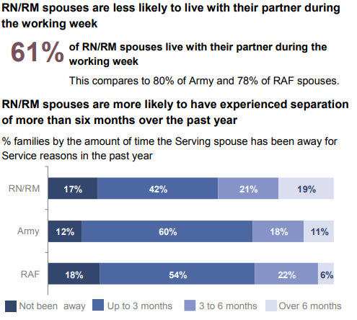
Armed Forces family living – facts and figures from the Ministry of Defence (Armed Forces Families Continuous Attitude Survey 2020)

Slide 8
What are the ‘challenges’ faced by families? What do they say?
‘I don’t want to make any new friends because you’re just going to move us again’
AFF, Childcare Survey
UK Tri-Service Families Continuous Attitude Survey Results 2020

Slide 9
The education challenges for families and Service children
One in five families with school age children had at least one child change schools for Service reasons in the past year (FAMCAS 2020).
Mobility brings multiple challenges (see next slide), including:
Disruption of friendship groups and family support networks
Lack of continuity in education (different schools systems/curricula/exam boards)
Variations to the amount and type of support available, particularly for those with additional needs
89% of Army families participating in the "Listening to Our Service children" survey (2019) reported considering leaving the Army because of the impact of Service life on their child.
Many children will be repeatedly separated from one or both parents, sometimes for periods of months or even years where a parent is serving unaccompanied overseas (see https://nff.org.uk/parental-absence/)
Not all operational activity receives media coverage. Some children will have parents working in high risk situations and will be concerned about their parent/s’ safety.
Every Service child’s experience is unique.

Slide 11
How are families supported? By whom?
Military Charities
Over 187 offer support e.g The Royal Navy and Royal Marines Charity, The Army Benevolent Fund, RAF Benevolent Fund and Royal Air Forces Association, Royal British Legion, SSAFA
Families Federations
Each Service has its own Families Federation that acts as an independent voice for families and offers support and advice.
Service family​
Networks in the UK ​
Service Children’s Progression Alliance,
Service Children in State Schools (England only)
Supporting Service Children in Education in Wales,
Veterans and Family Research Hub, Anglia Ruskin Uni​​​
Single Service Family support ​
(welfare support and social work):​​​
Royal Navy Family People Support (RNFPS)​​​
Army Welfare Support​​​
RAF Community Support​ (social work through SSAFA)​​
Devolved Nations Support
Royal Caledonian Education Trust rcet.org.uk
National Transitions Officer, Forceschildrenseducation.org.uk
SSCE Cymru, sscecymru.org.uk

Slide 12
For further information:
Bridget Nicholson
Director, Evidence & Strategy
Naval Families Federation
bridget.nicholson@nff.org.uk
Anna Hutchinson
Education & Childcare Specialist
Army Families Federation
educationsupport@aff.org.uk
Louise Briggs
Policy Advisor (Education & Childcare)
RAF Families Federation
louise.briggs@raf-ff.org.uk

